Slide 1
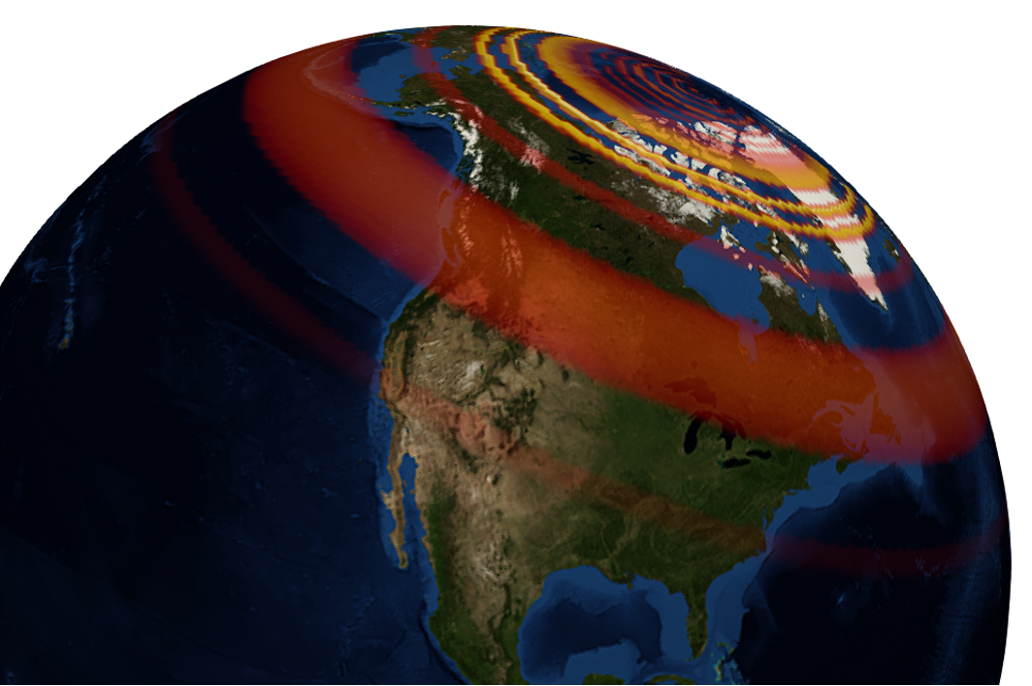
GEOL593: Seismology and Earth Structure, Spring 2023
Lecture 4: Seismic wave propagation 1
2/9/23
Ross Maguire
rossrm@illinois.edu
3014 NHB

Slide 2
Class schedule
 | Dates | Topic | Lab assignment
Week 1: | Jan 17, Jan 19 | Course overview | Lab 1: Python crash course
Week 2: | Jan 24, Jan 26 | Seismic signal processing | Lab 2: Introduction to Obspy
Week 3: | Jan 31, Feb 2 | Moment Tensors/ Inverse methods | Lab 3: Moment tensor inversion
Week 4: | Feb 7, Feb 9 | 🤮 No class, Ross ill | Seismic wave propagation 1
Week 5: | Feb 14, Feb 16 | Lab 4: Reference Earth models: The “1D” Earth | Seismic wave propagation 2
Week 6: | Feb 21, Feb 23 | Lab 5: Surface wave dispersion | Surface waves and normal modes
Week 7: | Feb 28, Mar 2 | Lab 6: Tomographic inversion | Imaging Earth Structure 1: Seismic tomography
Week 8: | Mar 7, Mar 9 | Lab 7: Receiver functions | Imaging Earth Structure 2: Seismic discontinuities / Research paper discussion
Week 9: |  | Spring break
Week 10: | Mar 21, Mar 23 | Anisotropy and anelasticity
Week 11: | Mar 28, Mar 30 | Planetary seismology 1 | Lab 8: InSight- Seismology on Mars
Week 12: | Apr 4, Apr 6 | Planetary seismology 2
Week 13: | Apr 11, Apr 13 | Machine learning in seismology 1 | Lab 9: Earthquake detection
Week 14: | Apr 18, Apr 20 | Machine learning in seismology 2
Week 15: | Apr 25, Apr 27 | Frontiers of seismology: What’s next?
Week 16: | May 2, May 4 | Research paper presentations

Slide 3


Slide 4
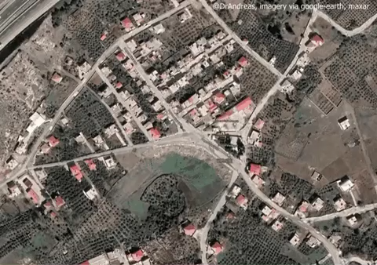

Slide 5
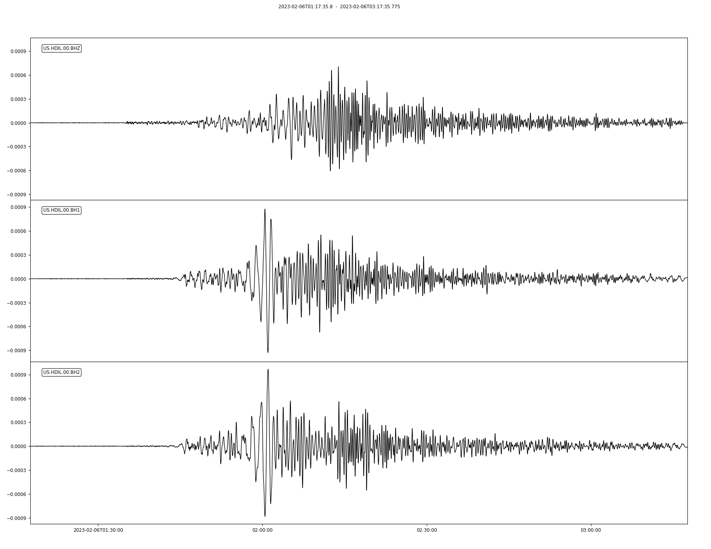
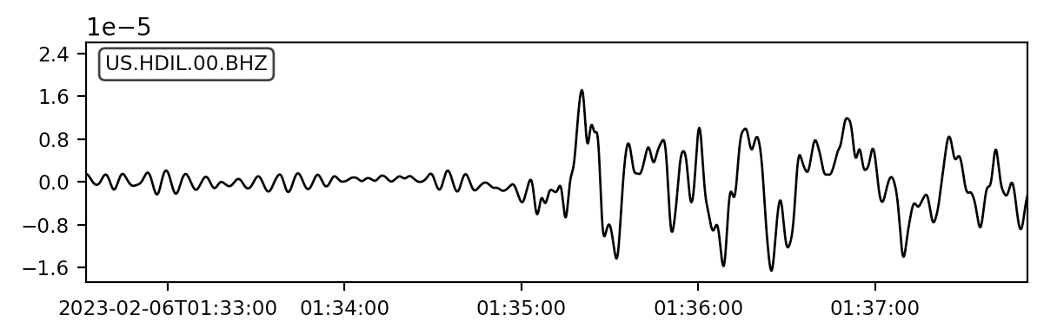
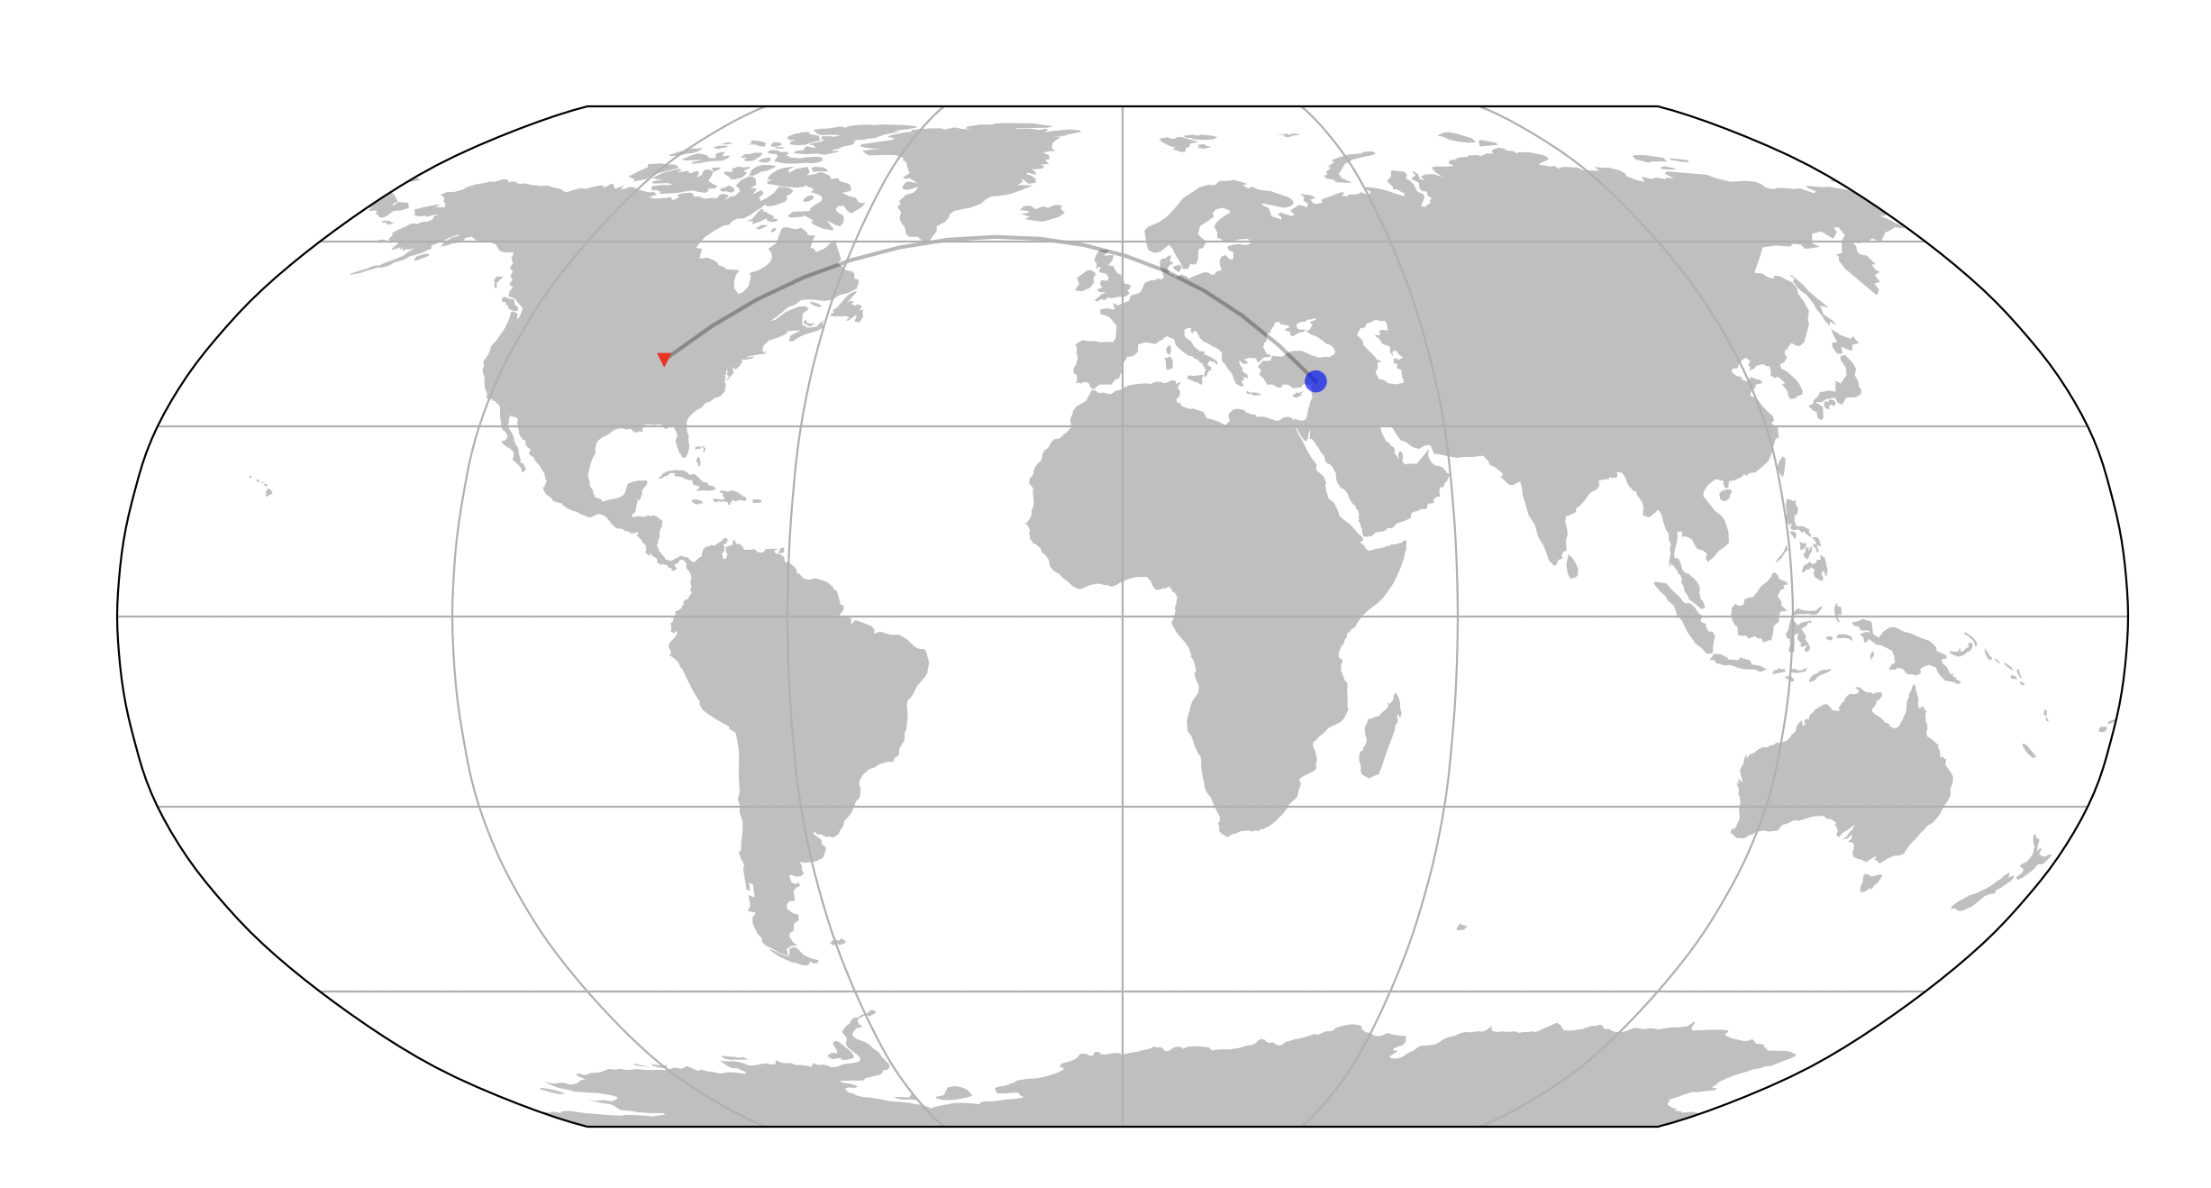

Slide 6
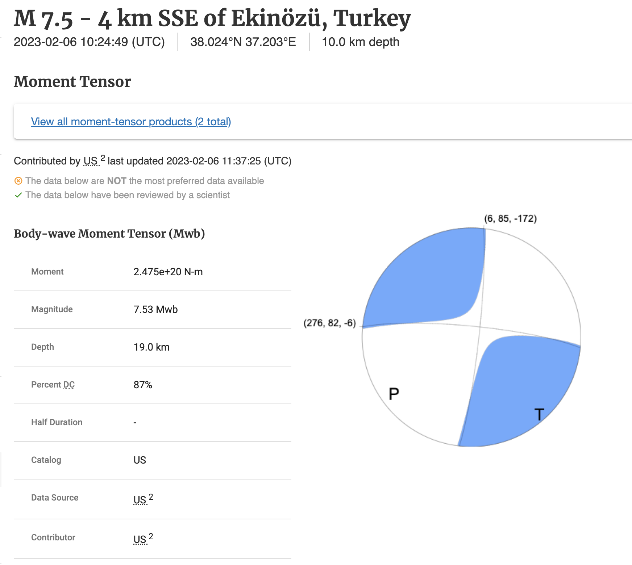
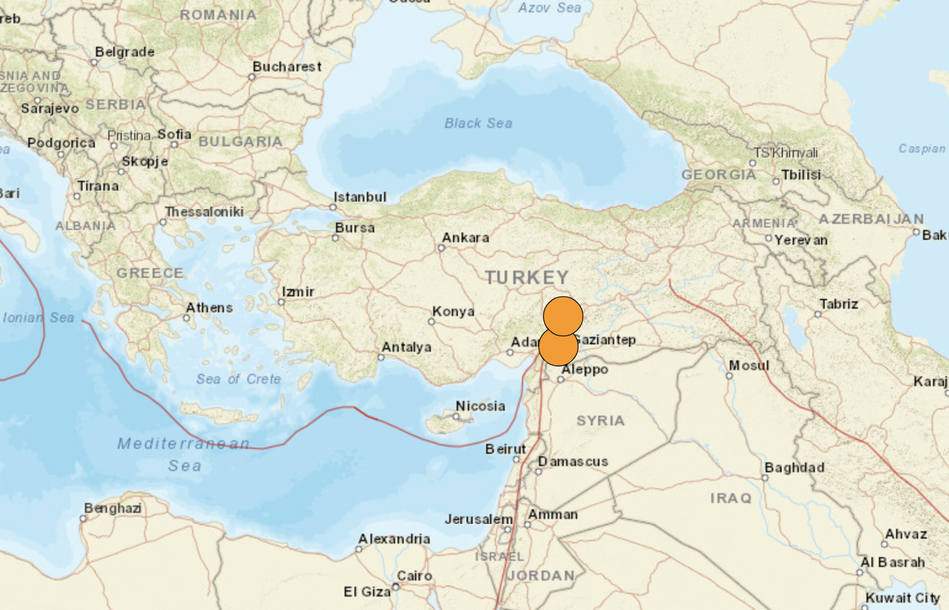
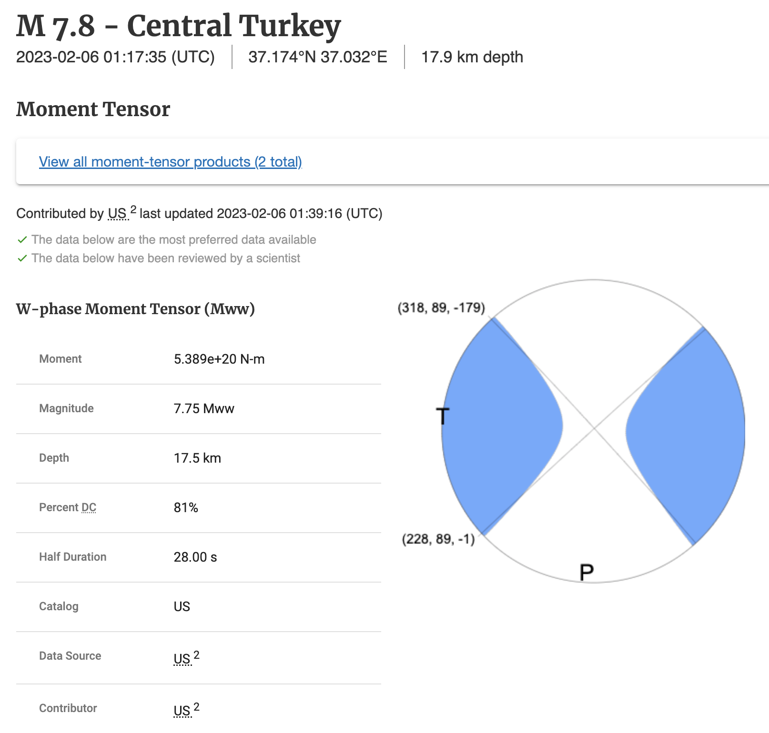
USGS moment tensor solutions

Slide 7
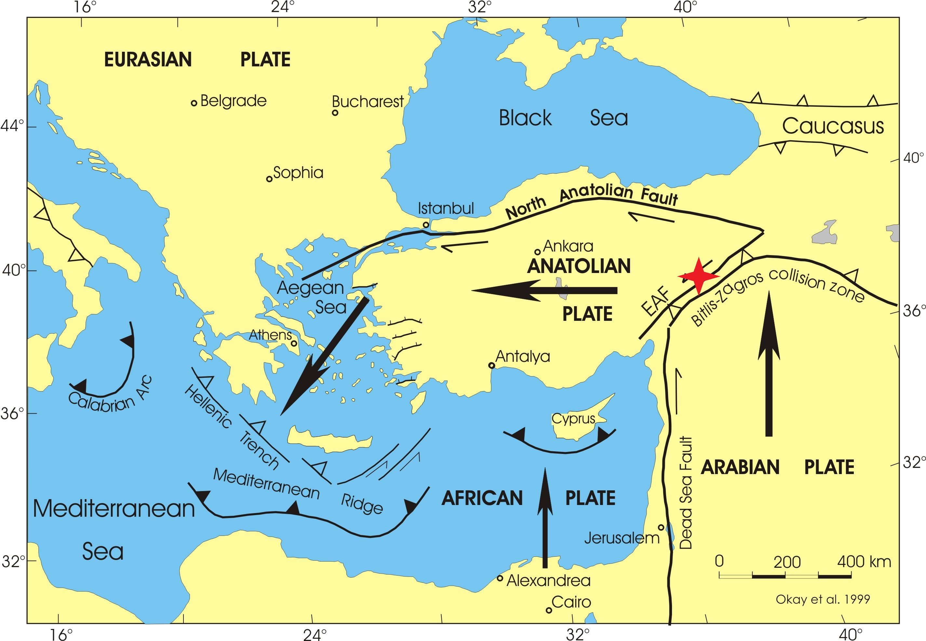
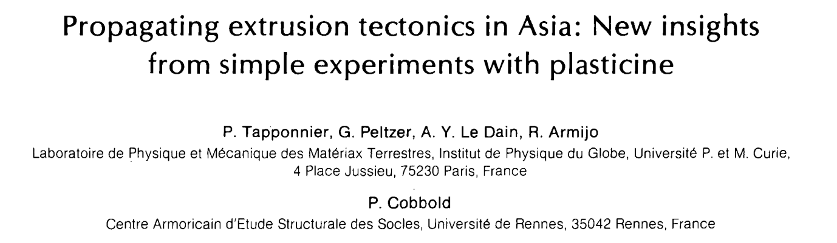
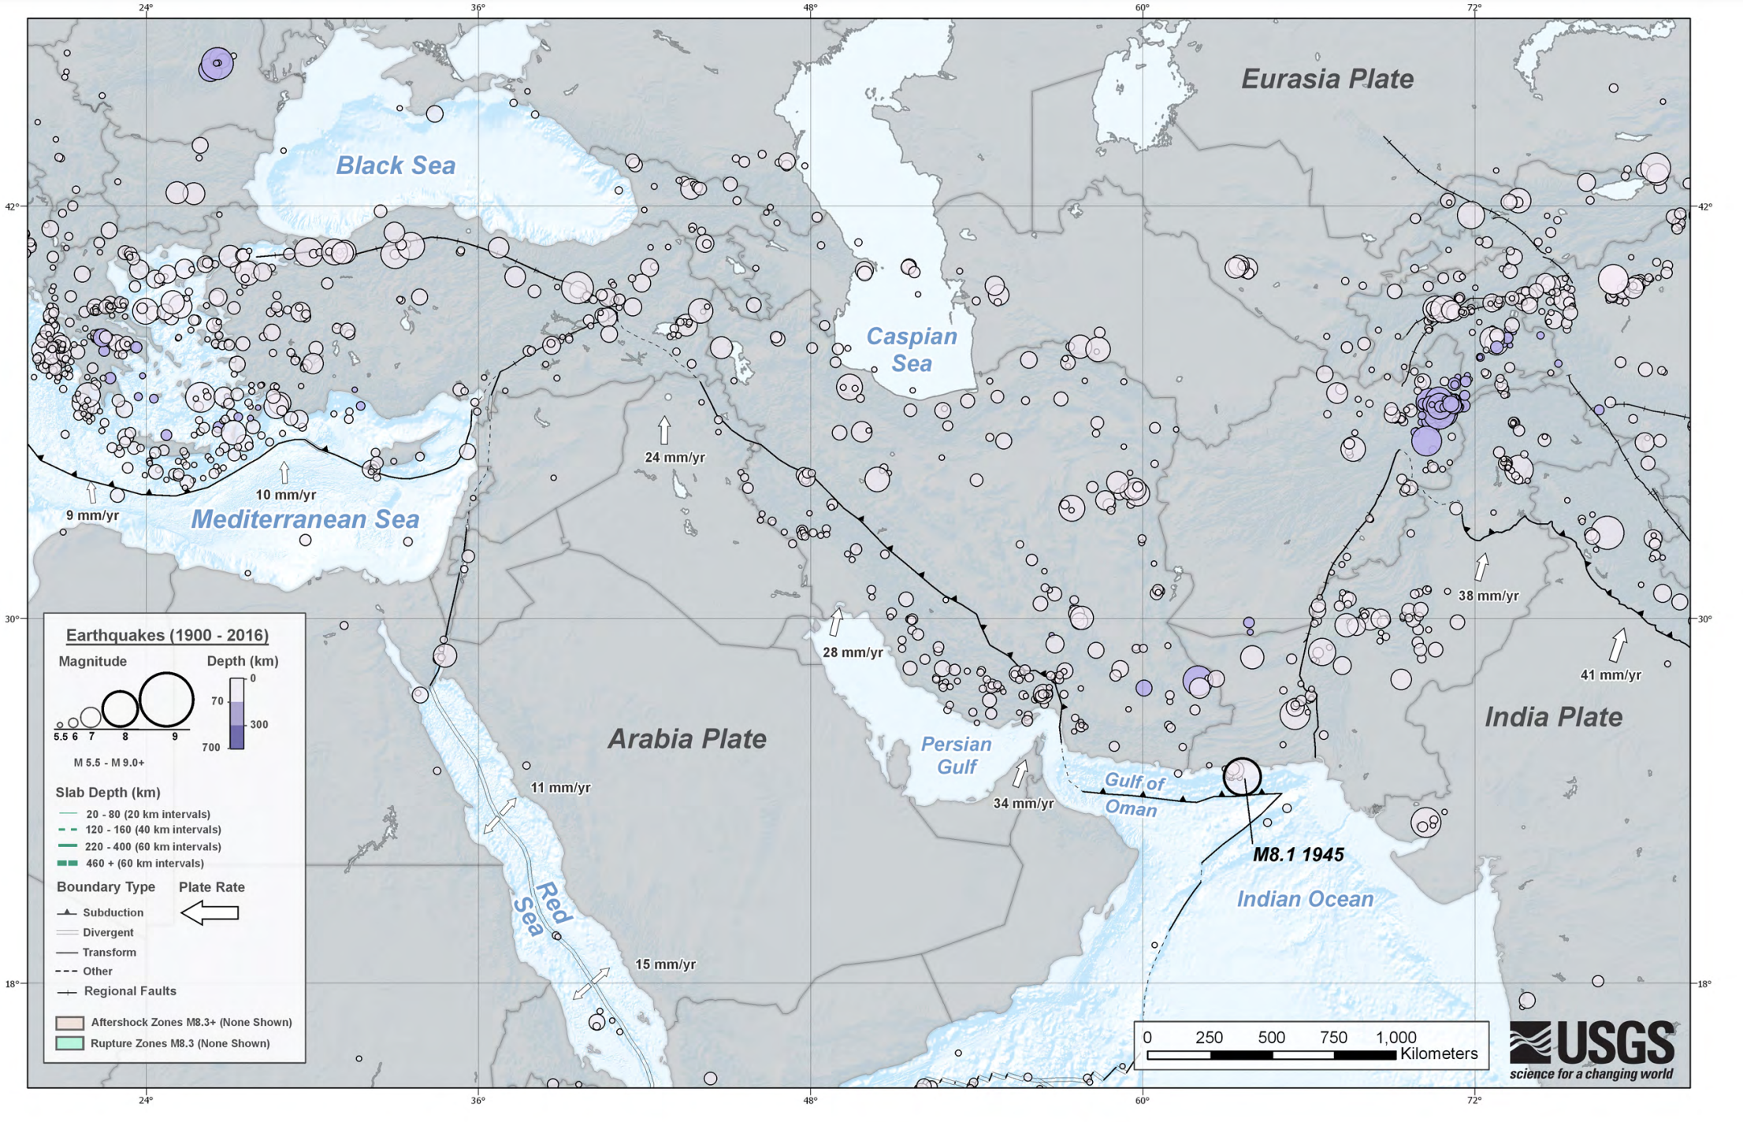
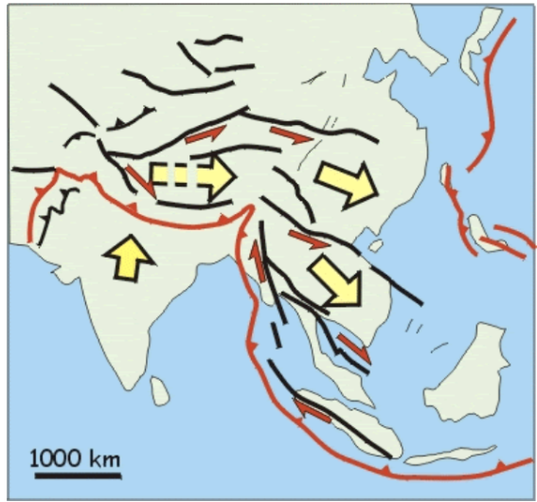
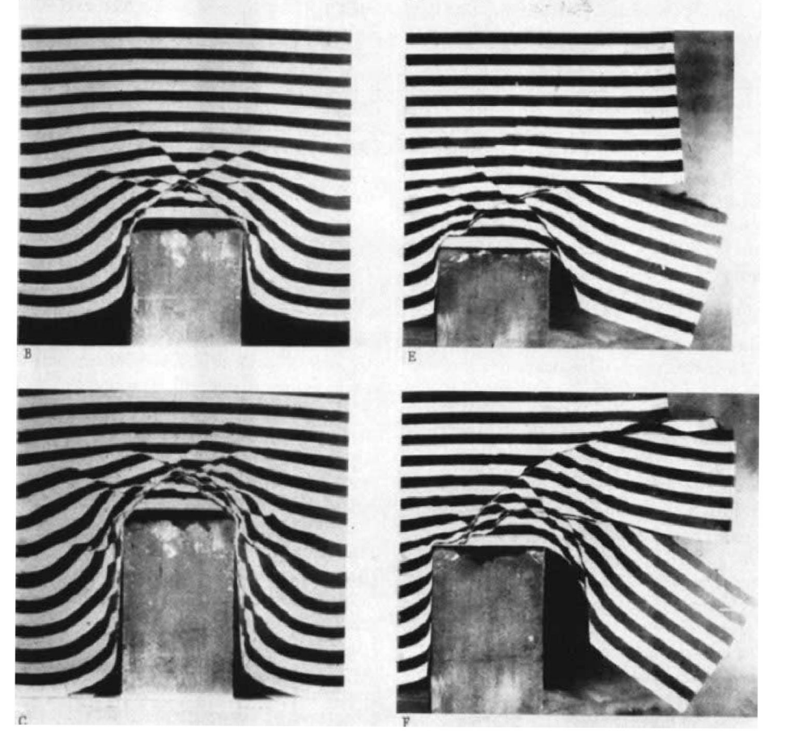

Slide 8
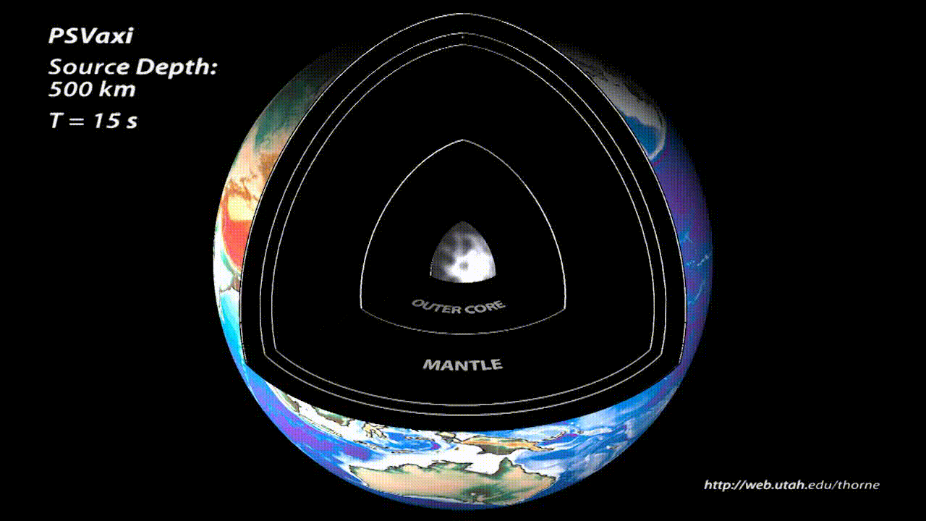
Global wave propagation

Slide 9
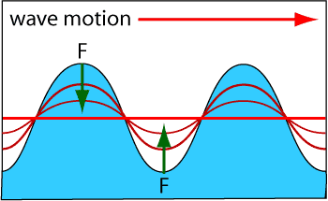
Why do waves propagate?
Perturbations to medium will propagate as waves if there is a restoring force to bring the medium back to an equilibrium position
For ocean waves, that force is gravity
For seismic waves, that force is elasticity

Slide 10
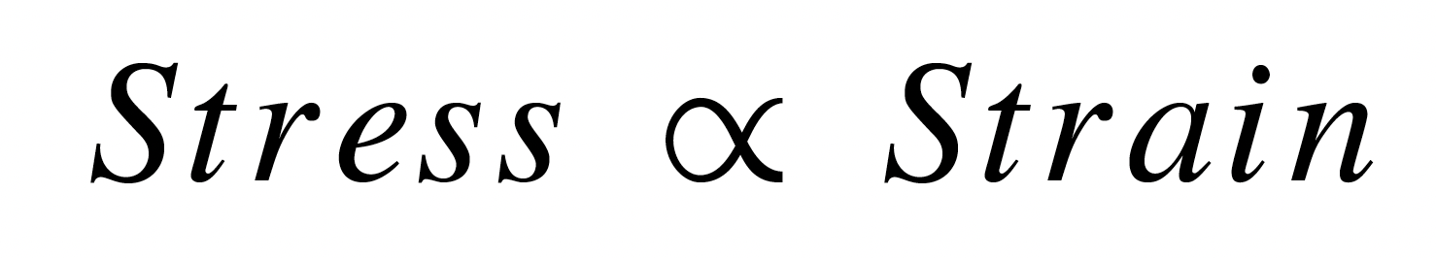
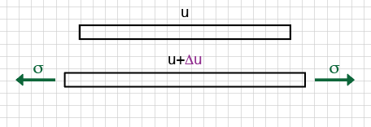
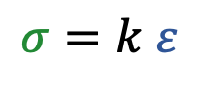
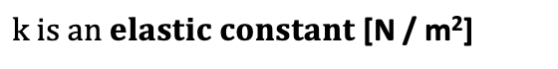
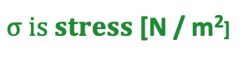
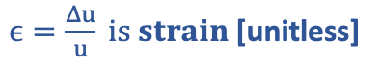
Stress and strain: Hooke’s law
Stress is linearly proportional to strain, for very small strain
in 1D
$$σ=k ε$$
$σ is stress$ [N / m²]
$k is an elastic constant$ [N / m²]
$ϵ=\frac{Δu}{u} is strain$[unitless]
What about in 3D?

Slide 11
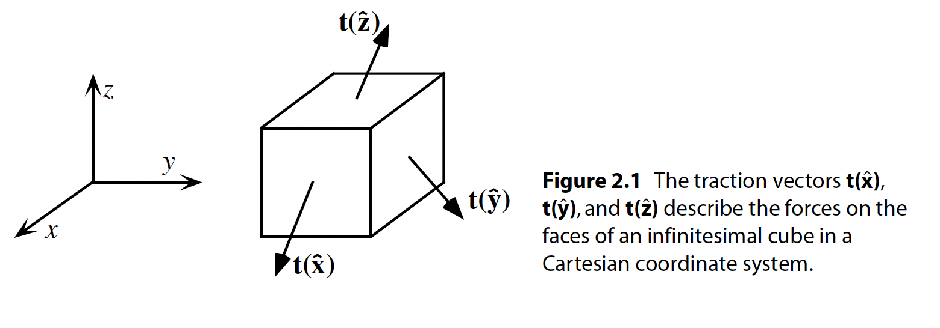
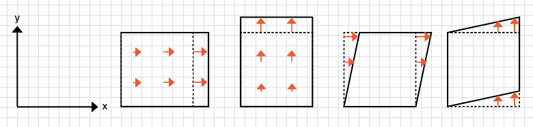

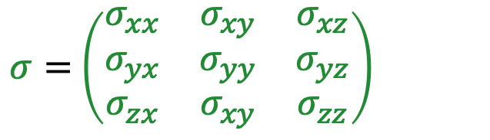
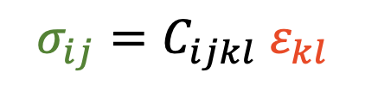
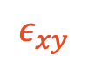
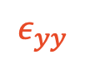
Stress and strain: Hooke’s law
Generalized Hooke’s law
$$σ_{ij}=C_{ijkl} ε_{kl}$$
3 x 3 tensor
3 x 3 tensor
Shearer, 2009
3 x 3 x 3 x 3 tensor with 21 independent elastic constants
$σ=$ $\left(\begin{matrix}σ_{xx} & σ_{xy} & σ_{xz} \\ σ_{yx} & σ_{yy} & σ_{yz} \\ σ_{zx} & σ_{xy} & σ_{zz}\end{matrix}\right)$
$$ε=\left(\begin{matrix}ε_{xx} & ε_{xy} & ε_{xz} \\ ε_{yx} & ε_{yy} & ε_{yz} \\ ε_{zx} & ε_{xy} & ε_{zz}\end{matrix}\right)$$
$$ε_{yy}$$
$$ε_{xy}$$

Slide 12
Isotropic media
An isotropic medium can be described by two elastic parameters
Bulk modulus (incompressibility)
Shear modulus

Slide 13
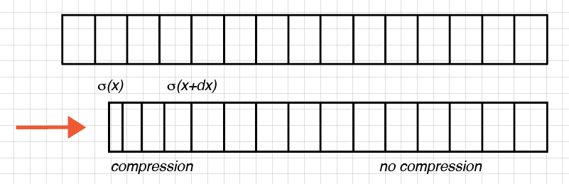
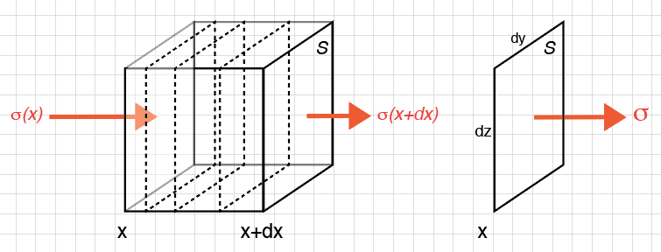
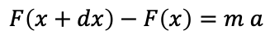
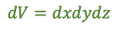
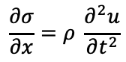
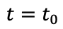
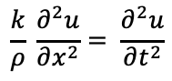
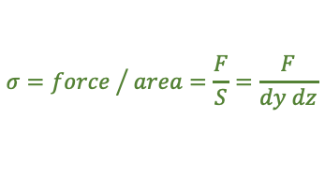
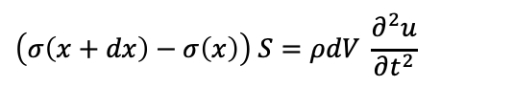
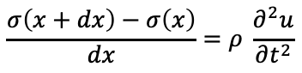
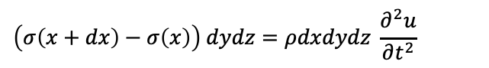
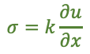
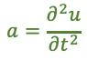
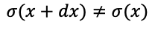
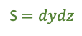
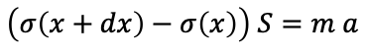
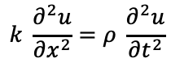
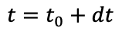
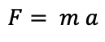
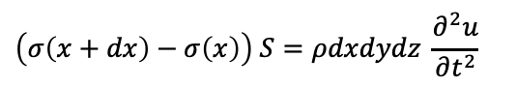

The wave equation in 1D
$$F= m a$$
$$F\left(x+dx\right)−F\left(x\right)=m a$$
$$t=t_{0}$$
$$\left(σ\left(x+dx\right)−σ\left(x\right)\right) S=m a$$
$$σ={force }/{ area=\frac{F}{S}=\frac{F}{dy dz}}$$
$$t=t_{0}+dt$$
$$\left(σ\left(x+dx\right)−σ\left(x\right)\right) S=ρdV \frac{∂^{2}u}{∂t^{2}}$$
$$a=\frac{∂^{2}u}{∂t^{2}}$$
stress gradient:
$$\left(σ\left(x+dx\right)−σ\left(x\right)\right) S=ρdxdydz \frac{∂^{2}u}{∂t^{2}}$$
$$σ(x+dx)≠σ(x)$$
$$dV=dxdydz$$
$$\left(σ\left(x+dx\right)−σ\left(x\right)\right) dydz=ρdxdydz \frac{∂^{2}u}{∂t^{2}}$$
S $=dydz$
$$\frac{σ\left(x+dx\right)−σ\left(x\right)}{dx}=ρ \frac{∂^{2}u}{∂t^{2}}$$
$$\frac{∂σ}{∂x}=ρ \frac{∂^{2}u}{∂t^{2}}$$
$$k \frac{∂^{2}u}{∂x^{2}}=ρ \frac{∂^{2}u}{∂t^{2}}$$
$$σ=k\frac{∂u}{∂x}$$
$$\frac{k}{ρ} \frac{∂^{2}u}{∂x^{2}}= \frac{∂^{2}u}{∂t^{2}}$$
$$c^{2} \frac{∂^{2}u}{∂x^{2}}= \frac{∂^{2}u}{∂t^{2}}$$

Slide 14
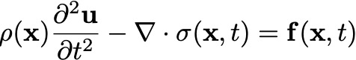
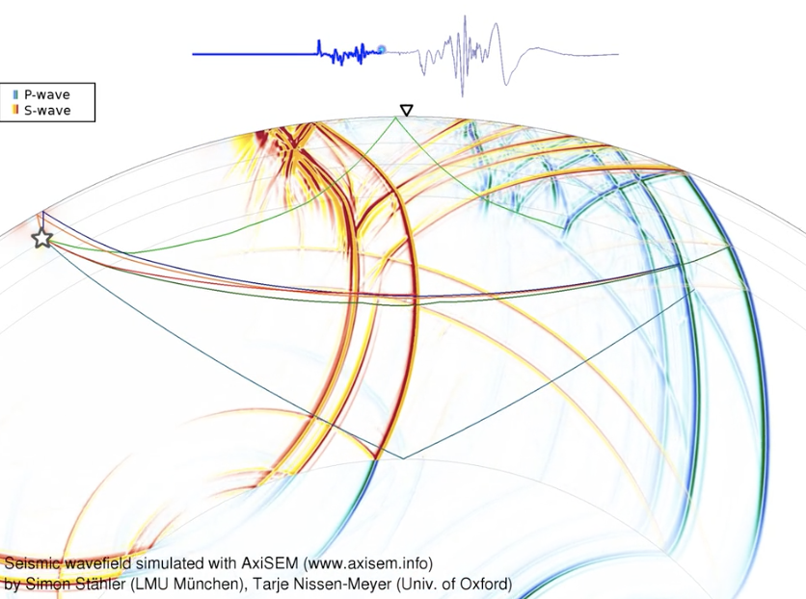
The elastic wave equation
u = displacement
𝞺 = density
t = time
𝞼 = stress
f = external force (e.g., earthquake)
x = location

Slide 15
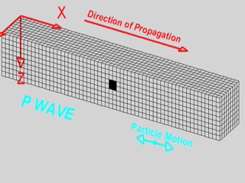



P-waves and S-waves
$$V_{P}=\sqrt{\frac{κ+\frac{4}{3}μ}{ρ}}$$
$$V_{S}=\sqrt{\frac{μ}{ρ}}$$
P-wave (primary, fast wave)
S-wave (secondary, slow wave)
P waves are longitudinal waves: particle motion is parallel to the direction of wave propagation
S waves are transverse waves: particle motion is orthogonal to the direction of wave propagation
P-wave
S-wave
particle motion
particle motion

Slide 16

Wavefronts and ray paths
Cox et al., 2020

Slide 17

Planar wavefront approximation
raypath

Slide 18

Global raypaths

Slide 19

What happens at an interface between two velocities?

Slide 20






Snell’s law
Fermat: the wave will follow a minimum-time path, but not necessarily the shortest path
Travel time between points P and P’:
The optimum path is where dT/dx = 0
$\frac{x}{\sqrt{a^{2}+x^{2}}}=sin⁡(i1)$, and $\frac{c−x}{\sqrt{b^{2}+{\left(c−x\right)}^{2}}}=sin⁡(i2)$, so
Snell’s Law

Slide 21
Travel time curves

Slide 22
Travel time curve of a layered medium

Slide 23


Smoothly increasing velocity
velocity
depth
time
distance

Slide 24
Why does velocity increase with depth?
Geological layering (sediments near surface, felsic upper crust, intermediate/mafic lower crust, ultramafic mantle)
Pressure effects on elastic moduli are larger than pressure effects on density
Mineralogical phase changes (e.g., in the mantle transition zone)

Slide 25

Shadow zones and triplications
Triplications: Caused by sharp velocity increases with depth

Slide 26



Slide 27
Shadow zones and triplications
Shadow zones: Caused by low velocity layers

Slide 28



Travel time curve of the Earth

Slide 29

PREM: The ‘Preliminary Reference Earth Model”

Slide 30

The ‘inverse’ problem: constructing a model from travel times
‘Classical’ approach
Herglotz–Wiechert formula: Allows you to invert for the velocity as a function of depth, given a traveltime curve, T(X)
dT/dX = p
The slope of the travel time curve gives the ‘ray parameter’, p, which is equal to the inverse of the velocity at the turning point of the ray

Slide 31

Non-uniqueness of P-wave travel time inversions

